Slide 1

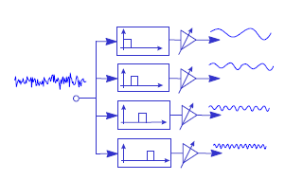
Digital Signal Processing
Course Instructor
Dr. Ali J. Abboud
Lecture No. 8: Digital Filters-IIR
Third Class
Department of Computers and Software Engineering
http://www.engineering.uodiyala.edu.iq/
https://www.facebook.com/Engineer.College1

Slide 2
Lecture Outline
Infinite Impluse Response of Digital Filters.
Methods for Calculation of Suitable Filter Coefficients.
Pole-Zero Placement Method.
Impulse Invariant Method.
Matched Z-Transform Method.
Bilinear Z-transformation Method.
Realization Structures for IIR Digital Filters .
Dr. Ali J. Abboud

Slide 3
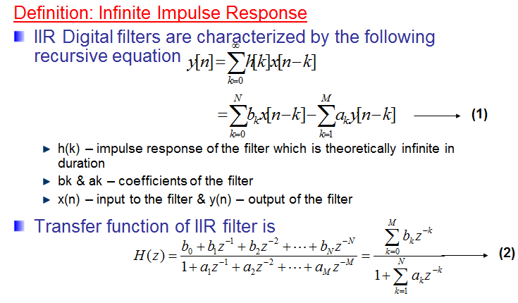
Infinite Impulse Response Digital filters
Dr. Ali J. Abboud

Slide 4
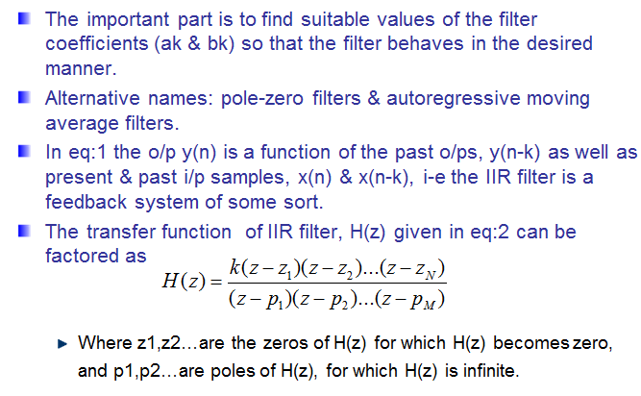
Infinite Impulse Response Digital Filters
Dr. Ali J. Abboud

Slide 5
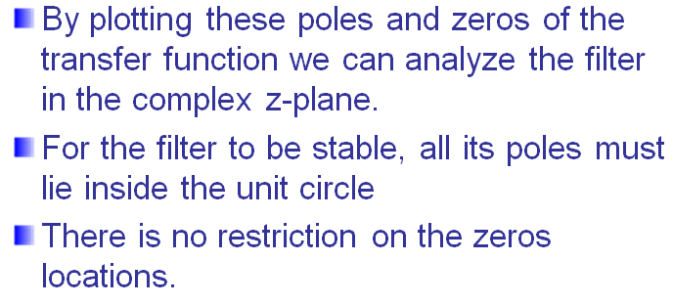
Infinite Impulse Response Digital Filters
Dr. Ali J. Abboud

Slide 6
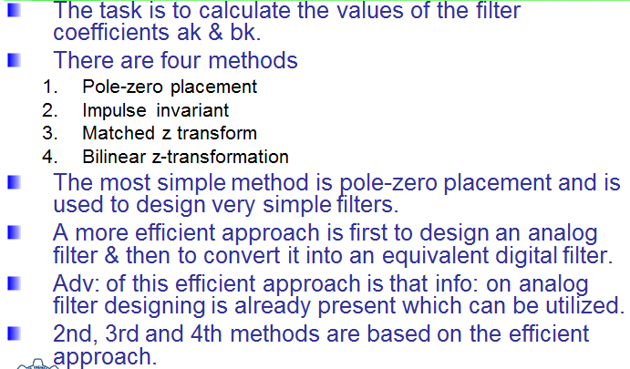
Methods for Calculation of Suitable Filter Coefficients
Dr. Ali J. Abboud

Slide 7
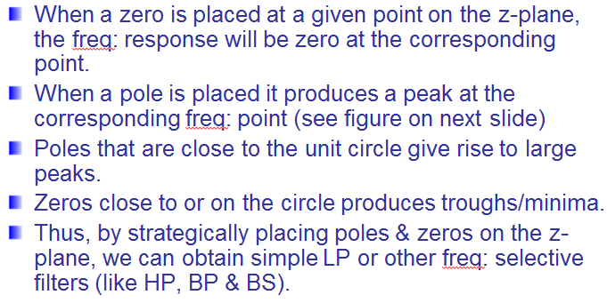
Pole-Zero Placement Method
Dr. Ali J. Abboud

Slide 8
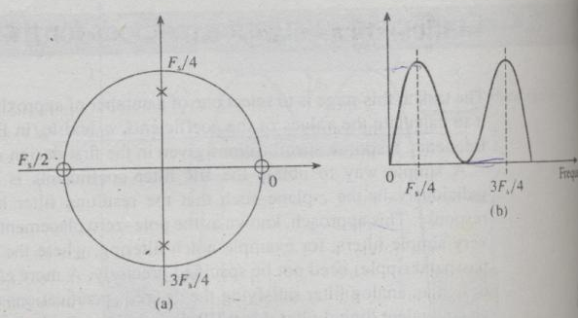
Pole-Zero Placement Method
Figure: (a) A pole zero diagram of a simple filter. &
(b) sketch of its frequency response.
Dr. Ali J. Abboud

Slide 9
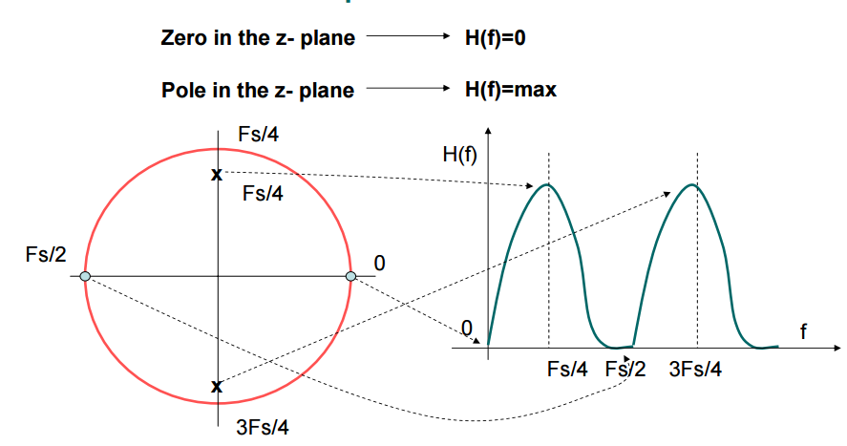
Pole-Zero Placement Method
Dr. Ali J. Abboud

Slide 10
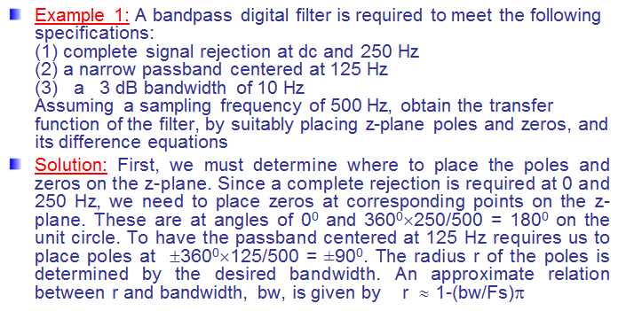
Example1
Dr. Ali J. Abboud

Slide 11
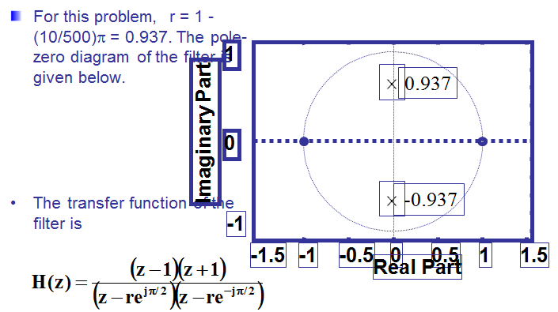
Example1
Dr. Ali J. Abboud

Slide 12
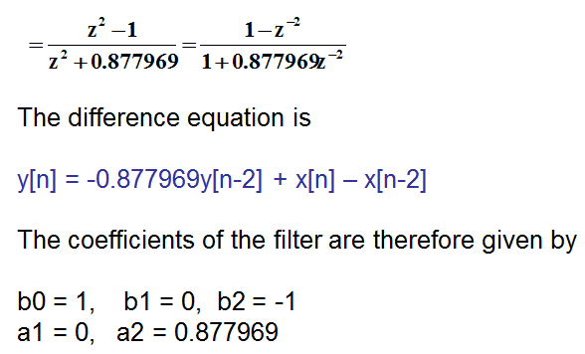
Example1
Dr. Ali J. Abboud

Slide 13
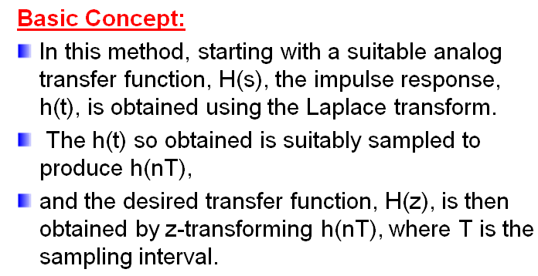
Impulse Invariant method
Dr. Ali J. Abboud

Slide 14
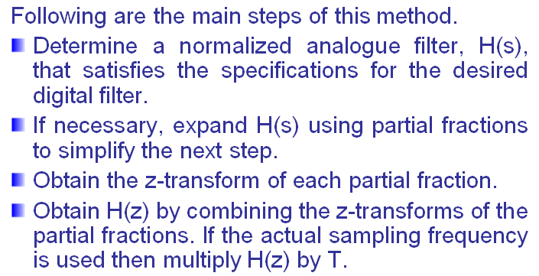
Steps of Impulse Invariant Method
Dr. Ali J. Abboud

Slide 15
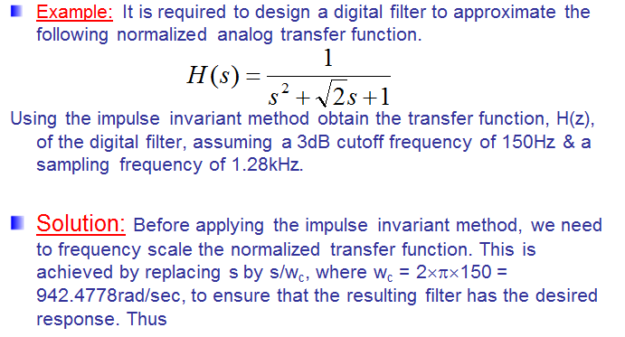
Example
Dr. Ali J. Abboud

Slide 16
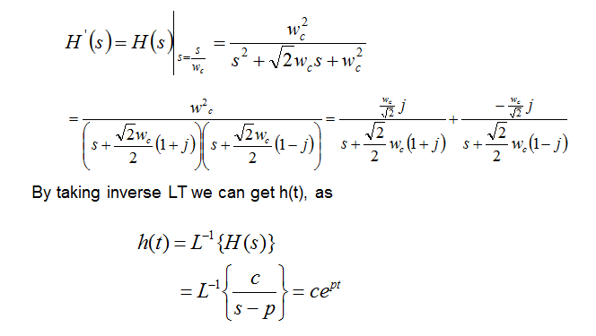
Example
Dr. Ali J. Abboud

Slide 17
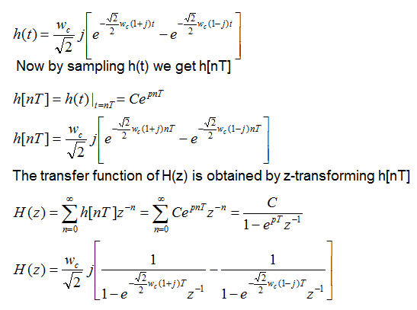
Example
Dr. Ali J. Abboud

Slide 18
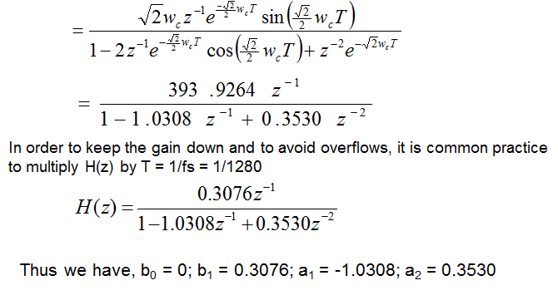
Example
Dr. Ali J. Abboud

Slide 19
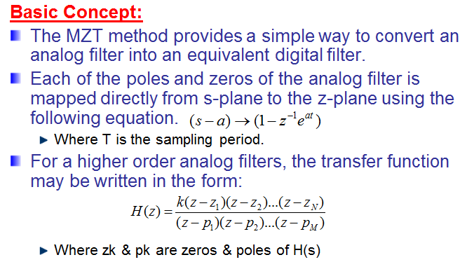
Matched Z-Transform Method
Dr. Ali J. Abboud

Slide 20
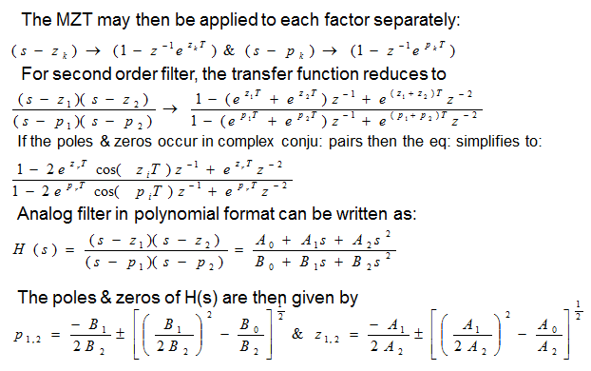
Matched Z-Transform method
Dr. Ali J. Abboud

Slide 21
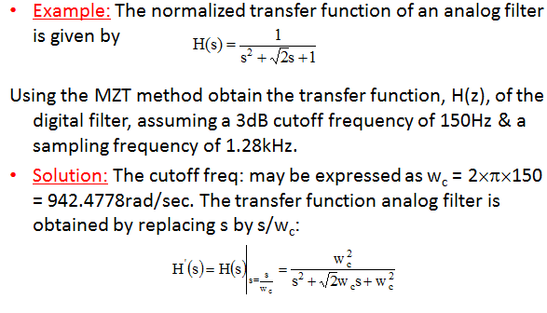
Example
Dr. Ali J. Abboud

Slide 22
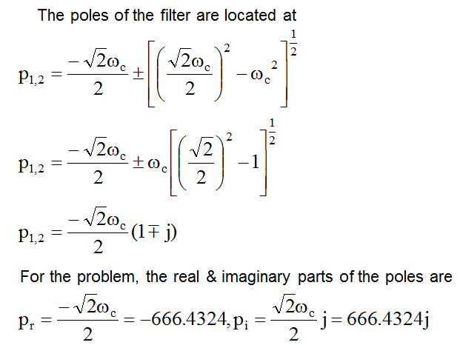
Example
Dr. Ali J. Abboud

Slide 23
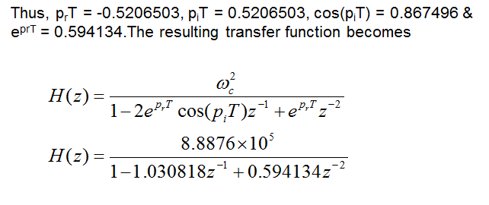
Example
Dr. Ali J. Abboud

Slide 24
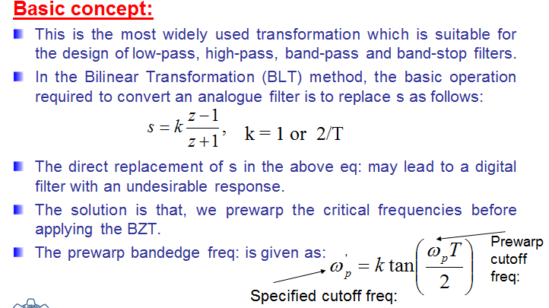
Bilinear z-transformation method
Dr. Ali J. Abboud

Slide 25
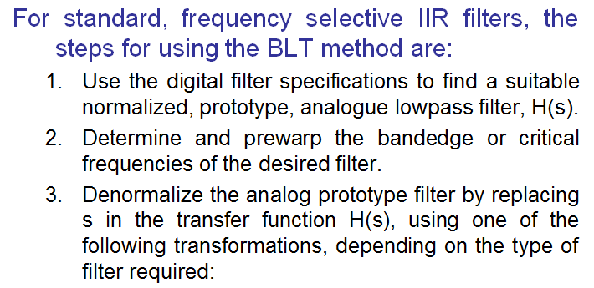
Steps of BLT method
Dr. Ali J. Abboud

Slide 26
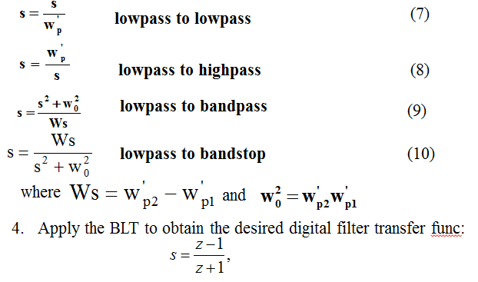
Steps of BLT method
Dr. Ali J. Abboud

Slide 27
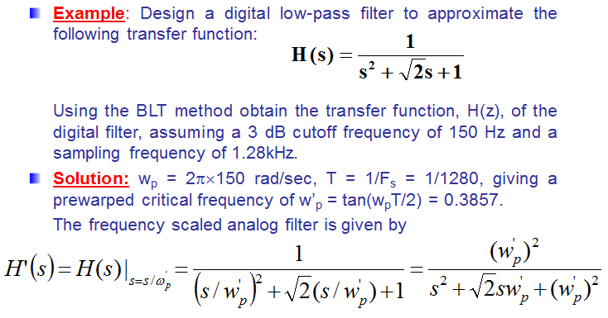
Example
Dr. Ali J. Abboud

Slide 28
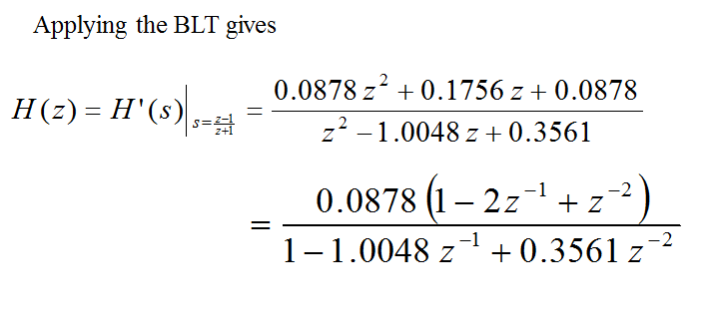
Example
Dr. Ali J. Abboud

Slide 29
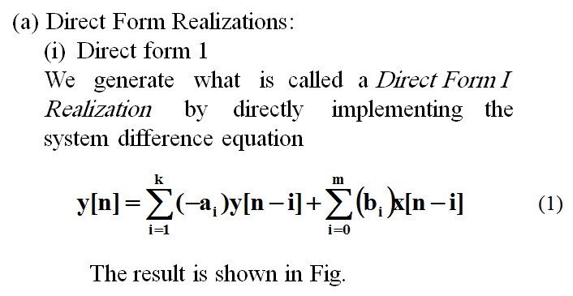
Realization Structures for IIR Digital Filters
Dr. Ali J. Abboud

Slide 30
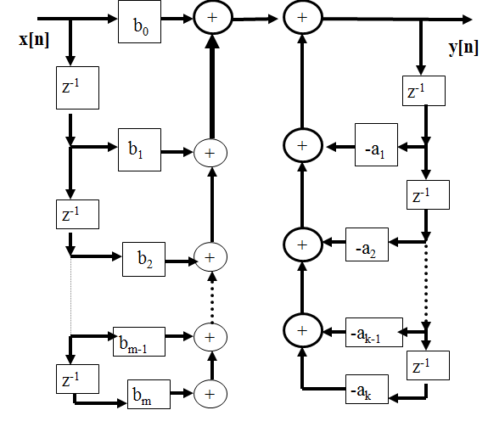
(i) Direct Form I
Dr. Ali J. Abboud

Slide 31
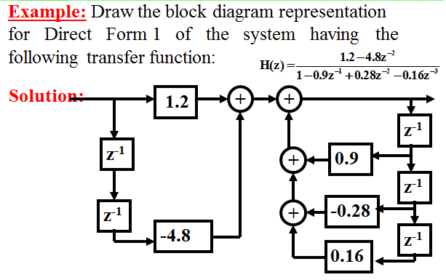
(i) Direct Form I
Dr. Ali J. Abboud

Slide 32
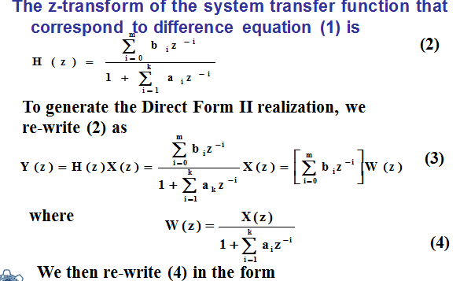
(ii) Direct Form II
Dr. Ali J. Abboud

Slide 33
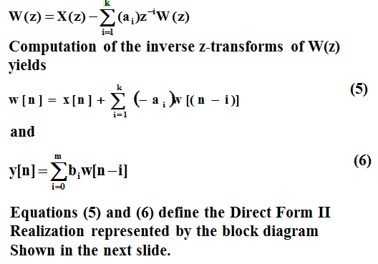
(ii) Direct Form II
Dr. Ali J. Abboud

Slide 34
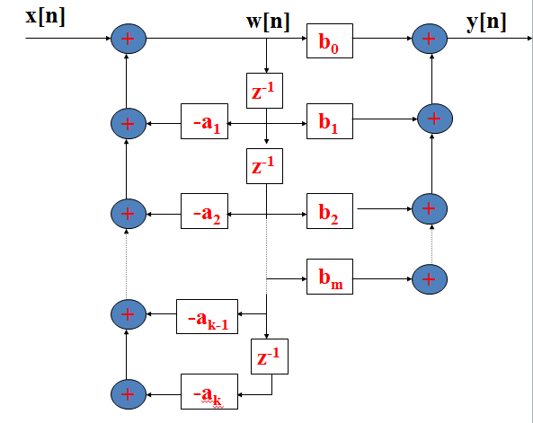
(ii) Direct Form II
Dr. Ali J. Abboud

Slide 35
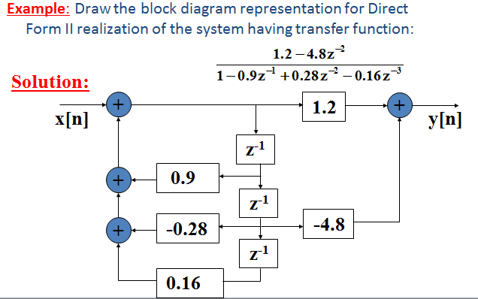
Example
Dr. Ali J. Abboud

Slide 36
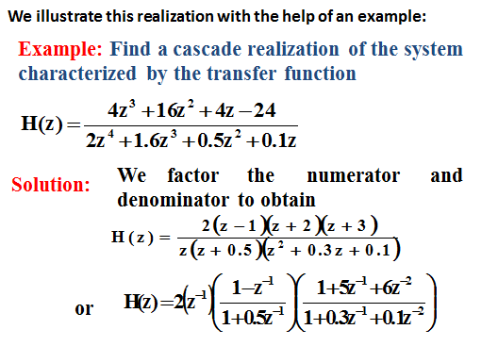
Cascade Realisation
Dr. Ali J. Abboud

Slide 37
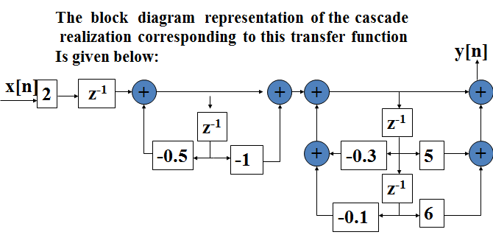
Cascade Realisation
Dr. Ali J. Abboud

Slide 38
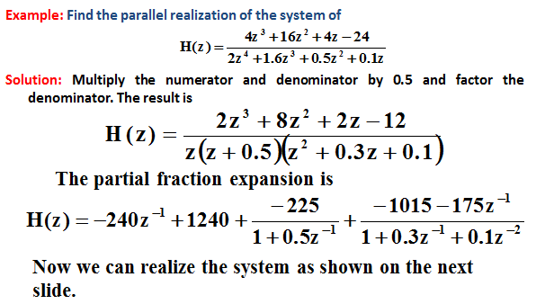
Parallel Realisation
Dr. Ali J. Abboud

Slide 39
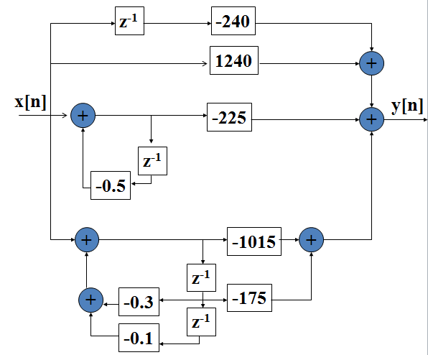
Parallel Realisation
Dr. Ali J. Abboud

Slide 40
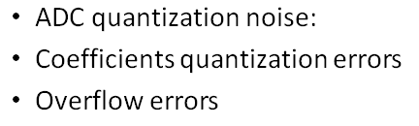
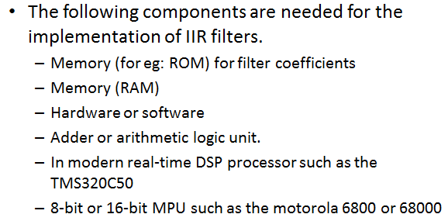
Finite word length effects in IIR filters
Dr. Ali J. Abboud

Slide 41
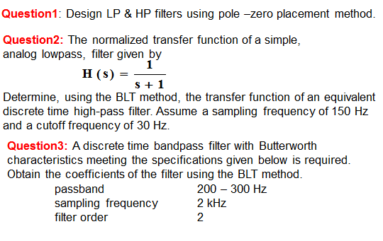
Tutorial
Dr. Ali J. Abboud

Slide 42
End of Chapter
Dr. Ali J. Abboud

